Slide 1
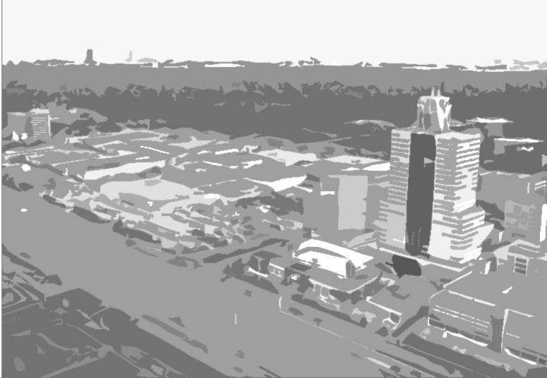
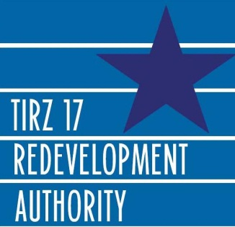

Grant Eligible Capital Improvement Plan
Memorial City TIRZ
DECEMBER 2015
THE GOODMAN CORPORATION
www.thegoodmancorp.com

Slide 2
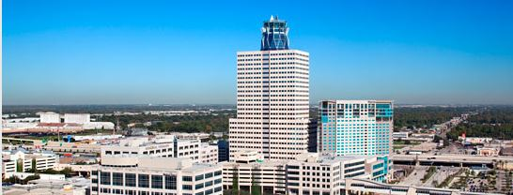
The Grant Eligible Capital Improvement Plan provides a roadmap and recommendations for the Authority to prepare for, identify, and pursue funding from state and federal sources.
Includes:
Background information related to the Authority’s organizational goals
Current information on demographics, land use, property ownership, transportation/transit information and trends
A prioritized and comprehensive list of projects that are eligible (either in whole or in part) for federal assistance, derived from the Authority’s CIP
General environmental conditions and potential issues
Grant programs, opportunities, and funding sources that can be applied to individual projects

Slide 3
Demographics

Slide 4
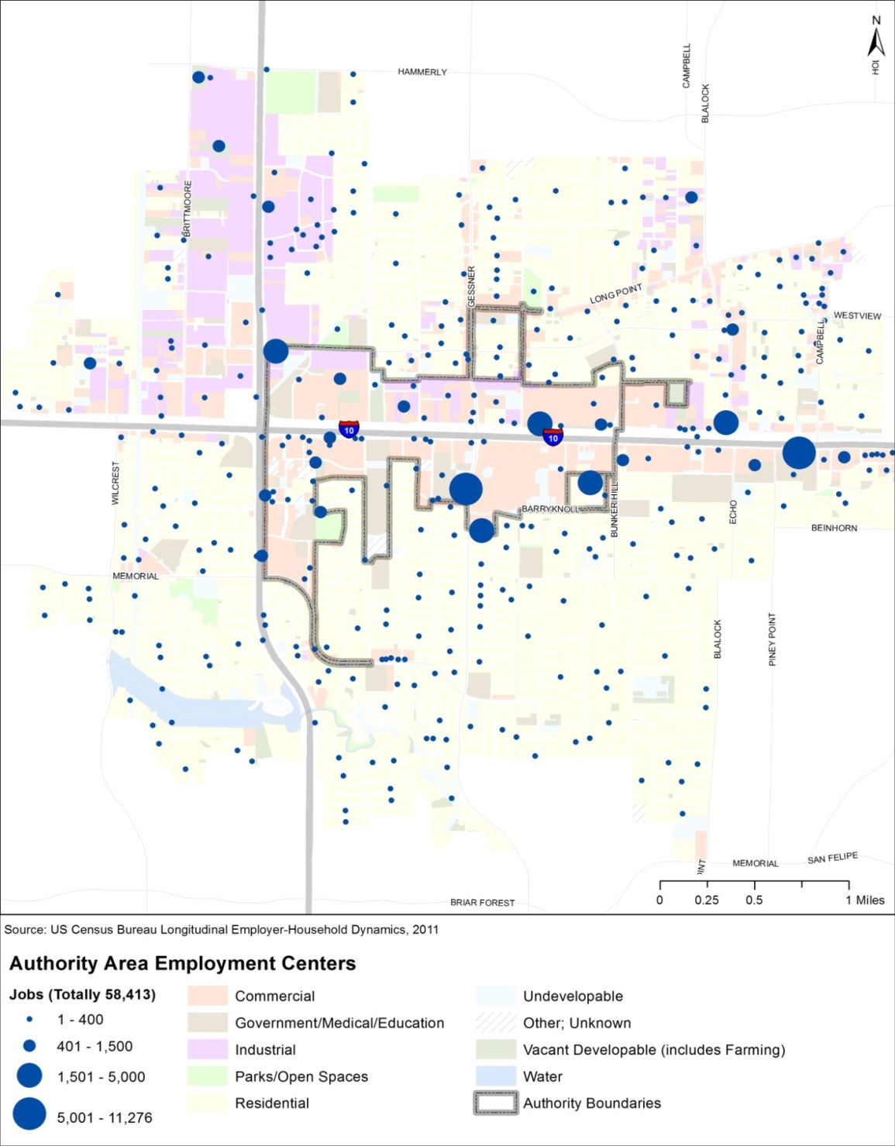
Commute and Employment

Slide 5
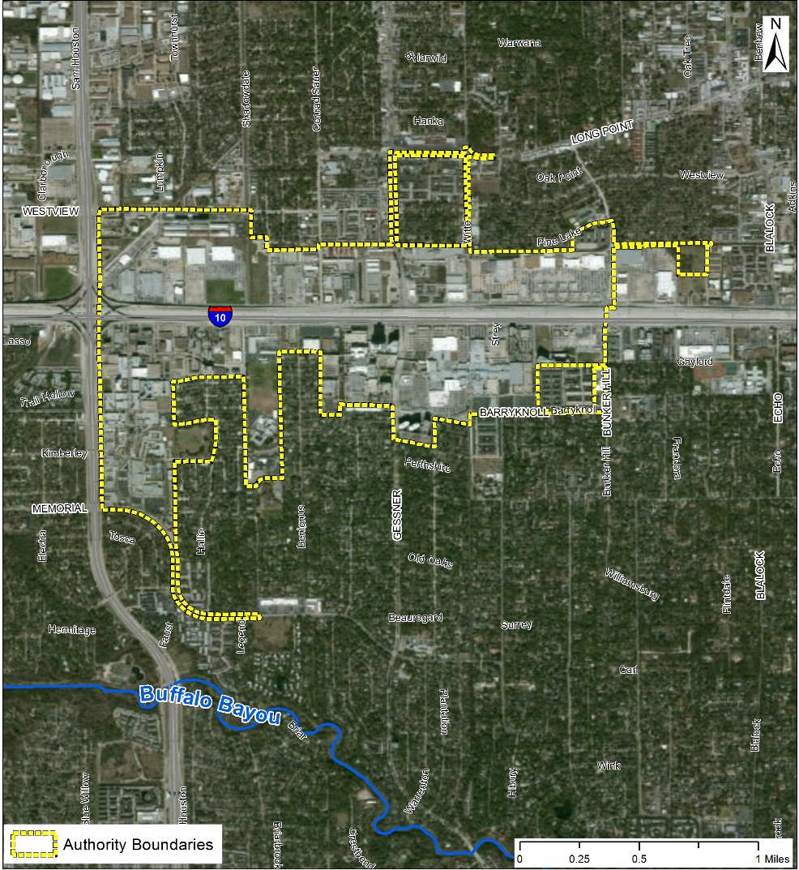
Projects support the Authority’s four major goals.
Improvements to:
Drainage and detention
Streets and mobility
Parks and green space
Pedestrian environments

Slide 6
Examination of existing conditions and planned improvements identified assets and challenges for Memorial City.
Assets
Transit access
Mobility improvements
Challenges
Drainage
Economic competitiveness
Bike infrastructure
Medical hub
Activity centers
High relative transit need north of I-10

Slide 7
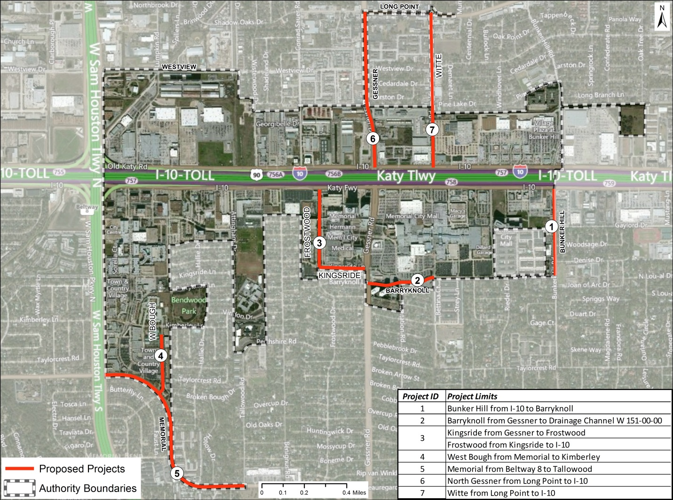
Eligible projects to which state and federal transportation funds were applicable became the Authority’s Grant-Eligible CIP.
These projects were analyzed for:
Mobility benefits
Emissions benefits
Safety benefits
Potential environmental issues
Cost
Current status
Timeline for completion
Notes:
Projects came from FY14 approved CIP

Slide 8
(1) Benefits
Improved mobility
Annual VMT reduction of 4,170
Annual emissions reduction of 0.022 ton
Annual safety benefit of $144,200
Notes:
Projects came from FY14 approved CIP

Slide 9
(2) Benefits
Improved mobility
Improved drainage
Annual VMT reduction of 24,025
Annual emissions reduction of 0.256 ton
Potential life-cycle cost savings of $2,246,478 ($56,162 annually)
Notes:
Projects came from FY14 approved CIP

Slide 10
(3) Benefits
Improved mobility
Improved drainage
Annual VMT reduction of 16,977
Annual emissions reduction of 0.181 ton
Potential life-cycle cost savings of $1,447,957 ($36,199 annually)
Notes:
Projects came from FY14 approved CIP

Slide 11
(4) Benefits
Improved mobility
Annual VMT reduction of 8,969
Annual emissions reductions of 0.096 ton
Notes:
Projects came from FY14 approved CIP

Slide 12
(5) Benefits
Improved mobility
Improved drainage
Annual VMT reduction of 9,930
Annual emissions reductions of 0.106 ton
Annual safety benefit of $774,800
Notes:
Projects came from FY14 approved CIP

Slide 13
(6) Benefits
Improved mobility
Improved drainage
Annual VMT reduction of 16,657
Annual emissions reduction of 0.178 ton
Annual safety benefit of $282,740
Potential life-cycle cost savings of $15,515,958 ($387,899 annually)
Notes:
Projects came from FY14 approved CIP

Slide 14
(7) Benefits
Improved mobility
Improved drainage
Annual VMT reduction of 20,182
Annual emissions reductions of 0.215 ton
Annual safety benefit of $57,300
Notes:
Projects came from FY14 approved CIP

Slide 15
The total cost of these improvements, in today’s dollars, is approximately $56,976,949. The total benefit of safety and state of good repair improvements, when quantified and aggregated, is $1,739,300 annually, or $69.5M over their useful life.
Notes:
This annual benefit does not include a monetization of the significant value of drainage improvements. The qualitative benefits associated with these projects are also significant. Roadway and sidewalk improvements in the project area will serve to enhance pedestrian safety and connectivity, as well as the quality of vehicular travel. The improvements also will provide better access to METRO’s new bus network and area amenities (medical, retail, educational, etc.).

Slide 16
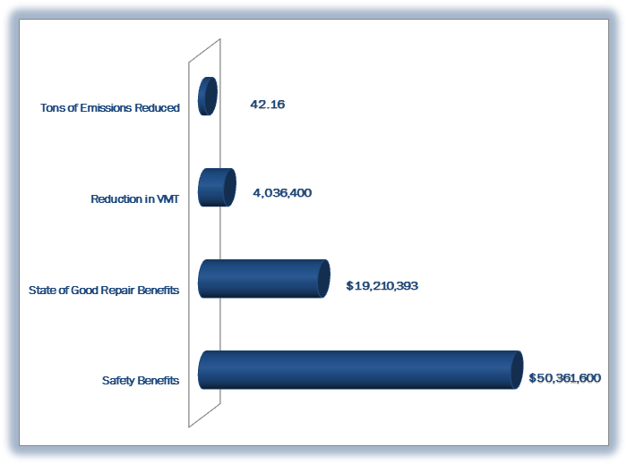
Life Cycle Value of Benefits

Slide 17
H-GAC Call for Projects
Results

Slide 18
Future Potential Funding Sources
Federal
Congestion Mitigation and Air Quality (CMAQ) Improvement Program
Surface Transportation Program (STP)
Transportation Alternatives Program (TAP)
Other Discretionary Federal Funding Opportunities (ARRA, TIGER)
State
Proposition 1 Funding
Proposition 7 Funding

Slide 19
The Authority can leverage existing assets to advance its overall mission of promoting economic development in Memorial City through investment in public infrastructure, particularly roads and drainage.
Safety
Access management
Improved traffic flow and LOS (intersection geometry, signal timing, road widening)
Bicycle and pedestrian improvements
Exceptional transit amenities
Community Identity
Project Recommendations

Slide 20
Further develop the scope of the “park and greenspace improvements” project in the existing CIP
Regular coordination with the Memorial Management District, TxDOT, and neighboring Villages so that partnerships and public monies are best leveraged
Add new grant eligible projects to the CIP
Complete planning and design work, if and when new grant eligible projects are added, to a point where the project scope and budget are well-defined
Emphasize mobility components of projects
Continue to monitor the status of the federal and state funding landscapes so that grants can be pursued on an on-going basis
Programmatic Recommendations

Slide 21
THE GOODMAN CORPORATION
www.thegoodmancorp.com

